Slide 1
Project Showcase
6G6Z0019: Synoptic Project
Name: Husnain Ahmed
Student ID: 21308666
Degree Programme: Software Engineering
Project Title: Image Recommendation System

Slide 2
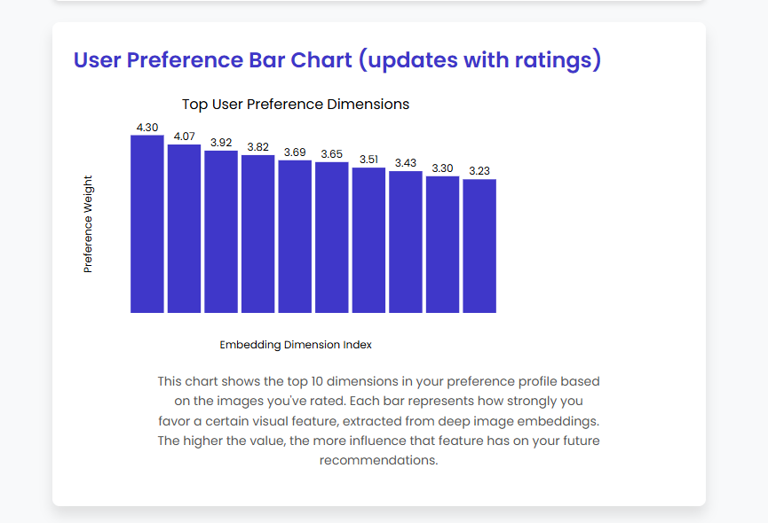
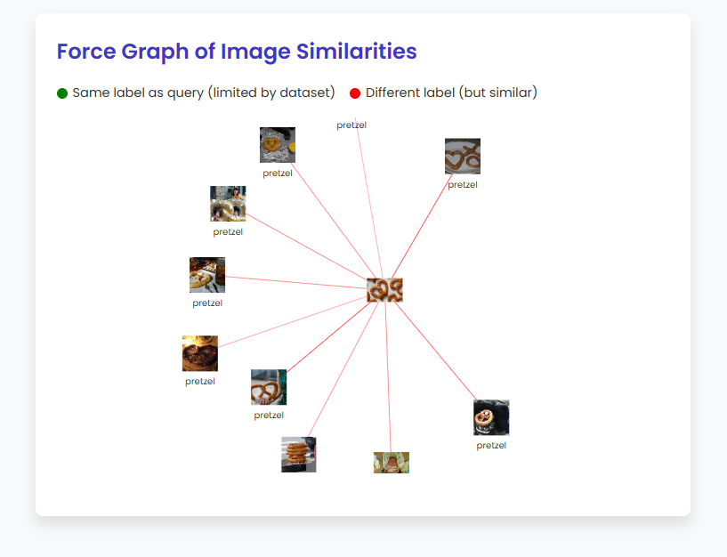
What is the project?
A personalised image recommendation system, designed to provide relevant images based on a user uploaded image
The goal is for the recommended images to be catered to the user’s preferences
User ratings will influence future recommendations
The way user data is used for image filtering is shown through a bar chart
The relationship between the uploaded image and the retrieved images is shown through a graph

Slide 3

Project Aims
Challenges (Research Questions):
How to empower users with greater control over the image recommendation process?
How to enhance transparency, allowing users to understand the rationale behind recommendations?
How to ensure user privacy by minimizing data collection and on-device processing?
Solutions:
User Control: Implement an intuitive interface with a 1 – 10 rating-based feedback mechanism, enabling users to actively shape future recommendations.
Transparency: Design the system to provide visual feedback through diagrams, illustrating how user interactions influence subsequent recommendations.
Privacy: Process all images locally on the device and do not make any use of cloud processing to avoid the storage of user data without explicit consent.

Slide 4

Reasons for developing this project
The system addresses the growing need for a personalized image recommendation system that isn’t biased towards any third parties, like the existing ones in various social media and image sharing sites such as Instagram and Pinterest.
Makes use of advanced data processing techniques like image feature embeddings and semantic search as well as implementing a dynamically updating user preference vector.
The inner workings of the algorithm are shown through various diagrams so that the user can understand and trust the system.
This project demonstrates a real-world application of various technologies and tools and aligns with current trends in data-driven, user centred design.
This project also offers an understanding into how image recommendation system’s work, how they can be made more transparent to gain the user’s trust as well as functions as a basis for any future projects based on personalized image recommendations.

Slide 5

Technology stack, Tools and libraries
Tools: VS Code, GitHub, GitHub Actions, Trello
Programming Languages: Python, JavaScript, TypeScript, HTML, CSS
Libraries / Packages: Annoy, TensorFlow, D3.js, Flask, Node.js
Dataset: Tiny ImageNet 200
Models: MobileNet V2, all-MiniLM-L6-v2
Testing: Jest, PyTest, Postman
User Feedback / Evaluation: Google Forms, RStudio

Slide 6
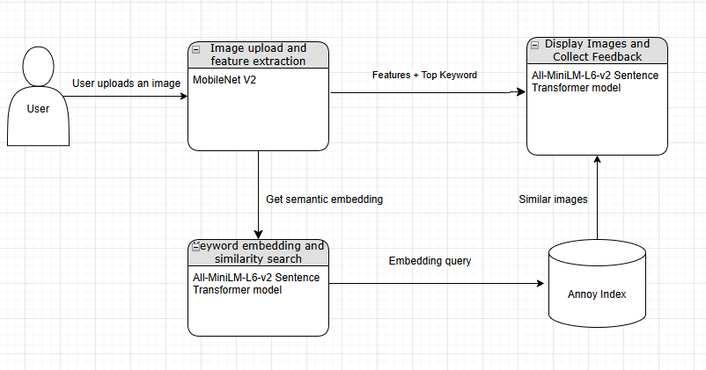
How my system works (workflow)
User uploads an image
The MobileNet V2 model extracts image features and generates a predicted keyword based on the image
The keyword is semantically analysed by the all-MiniLM-L6-v2 sentence transformer model to find the closest matching class name in my dataset
The extracted image features are used to query that specific class in the dataset and wind the closest matching images
The top 6 images are displayed to the user
The user can rate the images, which dynamically updates a user preference vector which is taken into account for future recommendations, the longer they use the system the more relevant images they will get as the system is ‘learning’ what they like

Slide 7
Live demonstration

Slide 8
Challenges during implementation
Technical issues: Overcoming challenges with specific software packages and tools (D3.js, Fuse.js).
Searching issues: Fuzzy search was insufficient, switched to Semantic search
Dataset issues: Limited dataset (built for efficiency, only 200 classes)
Image feature extraction issues: Model only trained on real life images
Implementing user preference weight: I settled on starting with 10% and maxing out at 60% with the rest of the recommendation algorithm using image features (content-based filtering).

Slide 9
Limitations, issues and future work
Model Limitations: The pre-trained MobileNetV2 model, while efficient and lightweight, was primarily designed to recognise real-world objects. A production-ready system could benefit from more advanced models with greater feature extraction capabilities, albeit at the cost of efficiency.
Dataset Scope: Future iterations could use a broader dataset or make calls to the Google Search API to provide a broader and potentially more accurate set of results, though the way image metadata is referenced will be different in other datasets so the code pertaining to managing images will need to be altered.
Real-time Updates: The reliance on pre-computed image features and Annoy indices prevents the image database from being updated in real-time which, although suitable for a small-scale project like this which was creating under a short timeframe, prevents the project from being upscaled in the future. Future work could explore traditional vector databases like Weaviate or Neo4j to address this.
User Preferences: The system has limited capacity to incorporate nuanced user preferences, such as allowing users to enter a string to specify a specific image feature such as shape or color intensity, this could be a possible future addition to the system.
Storing User Data: Though this has not been done due to a focus on privacy, future iterations of the system could store user interaction data through user profiles and use that for collaborative filtering with other users to increase the relevance of recommended images.
Evaluation: Additional testing and evaluation, including user studies and quantitative metrics, would provide a more comprehensive assessment of the system's performance and usability.
Documentation: More thorough documentation would be a good decision such as API documentation through swagger.

Slide 10
Achievements
Successfully implemented an on-device image recommendation web application.
Leveraged the use of MobileNet V2 embeddings and the Annoy library for instant image searching capabilities withing a local dataset.
Designed the system with a focus on user empowerment through transparency and control.
Prioritised ethical considerations, user privacy, and control in the system's design.
Effectively integrated several different technologies to deliver a functional and user-friendly image search experience.

Slide 11
Conclusion
Overall, this project was successful in demonstrating the feasibility of on-device image recommendation with a focus on user empowerment.
The recommended images were deemed as relevant most of the time and show that the system meets its intended purpose.
The design of the system prioritises ethical considerations, user privacy, and control.
Through this project, I've gained valuable insights into the complexities of balancing user empowerment with the technical challenges of image recommendation through the use of machine learning models.

